Slide 1
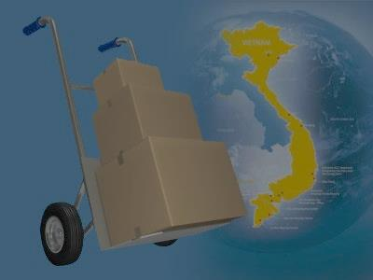
A web-based application that manages the activities of delivery service system by coach
i-DELIVER
SPRING 2014 - Group 18
1

Slide 2
Team members
Supervisor: Nguyễn Trọng Tài
Nguyễn Thanh Tùng
Lê Phúc Lữ
Nguyễn Tấn Đức
Team leader: Đào Bảo Long
2

Slide 3
Outline
Scenario problems
Propose solution
Feature and constraint of new system
Demonstration
Future plan
Technology & development environment
Algorithm description
3

Slide 4


Scenario problems
Advantages Disadvantages
No need to setup
Less training
time
Paper documents
No statistics report
Internet connection unnecessary
Ineffective manual work
4

Slide 5




Actors of system
Customer: person requests for package delivery from their location to another location.
Guest: same as customer but don’t log in
to system so be restricted in some function.
Staff: persons in charge of manage delivery request and manage journey.
System admin: person take
responsibilities of manage staff
and fee.
5

Slide 6


Propose scenario
[Optional] Payment online
Post request
Notify payment
information
Provide delivery
service, tracking request
Manage services,
users
Manage journey
information, request
Provide mechanism to manage
6

Slide 7

Some definitions
4h
178 km
8h
308 km
3h
169 km
Đà Lạt
Cần Thơ
Cà Mau
Sài Gòn
Volume
(L x W x H)
7:00 AM
26 May 2014
7:00 AM
SCHEDULES
STATIONS
STAGES
ROUTES
COACHES
TRIPS
7

Slide 8
Problems
Trip | Cà Mau | Cần Thơ | Sài Gòn | Đà Lạt | Đà Nẵng | Volume
1 |  |  |  |  |  | 30
2 |  |  |  |  |  | 350
3 |  |  |  |  |  | 400
4 |  |  |  |  |  | 240
Requests (from A to B)
Cà Mau – Cần Thơ: 30 dm³.
Cần Thơ – Đà Lạt: 40 dm³.
Đà Lạt – Đà Nẵng: 50 dm³.
Assign these requests that satisfying constraints about: volume, time.
8

Slide 9
Detail solution
Find ways:
Build graph G=(V, E) and use breath first
search algorithm to find some ways.
For each way, check the direction is not backward base on the longitude and latitude of stations. Condition:
9

Slide 10
Three main steps
Step 1: check if request can be delivered on one trip starts at A and end at B.
Step 2: check if request can be delivered by multiple trips that starts/ends at stations of the found way.
Step 3: check if request can be delivered by multiple trips and its may be transferred at middle of way.
10

Slide 11
Find routes and trips
Using heuristic idea, try to find:
One route for whole way.
One route for each stages of way.
Two/three/four routes for whole way.
With each list routes, find trips for each route and if satisfy all constraints, store as a solution.
C
E
A
B
D
11

Slide 12
Choose the best solution
For list of found solutions, sort them base on some criterions:
The arrival time of last trip.
The number of used trips.
Then choose the first solution of list with best fit all constraints.
12

Slide 13
Positive of algorithm
Use greedy thinking so fast to find out local optimal solution of given problem.
Some list data use for the one request is used for all next request.
Estimate complexity of algorithm:
O((k|V||E|² + |E|⁴) x |T| x |R| x |S| x |I|).
with |T|, |R|, |S|, |I| are number of trips, routes, stages and requests.
13

Slide 14
Negative of algorithm
The steps of algorithm are separately performed so in some case, the solution exist but can not be found (tricky or special case).
Some step of algorithm can be implemented better to reduce the complexity but still not have done.
14

Slide 15







Technology & development environment
15

Slide 16

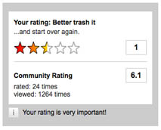



Feature of new system
Request for packages delivery easily
Simple way to tracking packages
Online payment
Easy to manage packages
Rating and comment
Statistics on revenue
16

Slide 17


Constraints of new system
Each station must have staff with basic computer skills to mange request & journey
Each station must have computer connects to Internet
17

Slide 18
DEMONSTRATION
18

Slide 19



Future plan
Develop mobile applications for manage packages pick-up/delivery process at customer’s house
Develop and optimize algorithms for coach scheduling and reduce cost of delivery process
19

Slide 20
Thanks for your listening! Q&A
20

